Slide 1
SUPPORT VECTOR MACHINES-ML METHOD

Slide 2
Contents
Introduction to Support Vector Machine (SVM)
Understanding Hyper Planes
What is a Hyper Plane
Hyper Plane Separation
Linear Separators
Classification Margin
Mathematical Approach to Linear SVM
SVM in R
SVM Modeling
ROC and Area Under ROC Curve

Slide 3
Introduction to Support Vector Machines
Support Vector Machines (SVM's) are a relatively new learning method generally used for classification problem.
Although the first paper dates way back to early 1960’s it is only in 1992-1995 that this powerful method was universally adopted as a mainstream machine learning paradigm
The basic idea is to find a hyper plane which separates the d-dimensional data perfectly into its classes.

Slide 4



What is a Hyper Plane
In two dimensions, a hyper plane is defined by the equation:
This is nothing but equation of line.
The above equation can be easily extended to the p-dimensional setting:
In short,
In p > 3 dimensions, it can be hard to visualize a hyper planes.
$$W_{1}X_{1}+W_{2}X_{2}+b=0$$
$$W_{1}X_{1}+W_{2}X_{2}+…+W_{p}X_{p}+b=0$$
$$W^{T}X+b=0$$

Slide 5



Separating a Hyper Plane
Binary classification can be viewed as the task of separating classes in feature space:
Fig. 01: Binary Classification
$$W^{T}X+b<0$$
$$W^{T}X+b=0$$
Here line separates data into two parts
$$W^{T}X+b>0$$

Slide 6
Linear Separators
The objective in SVM is to find optimum separator
Fig. 02: Linear Separators
Which of the linear separators is optimal?

Slide 7
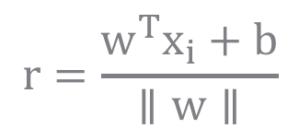
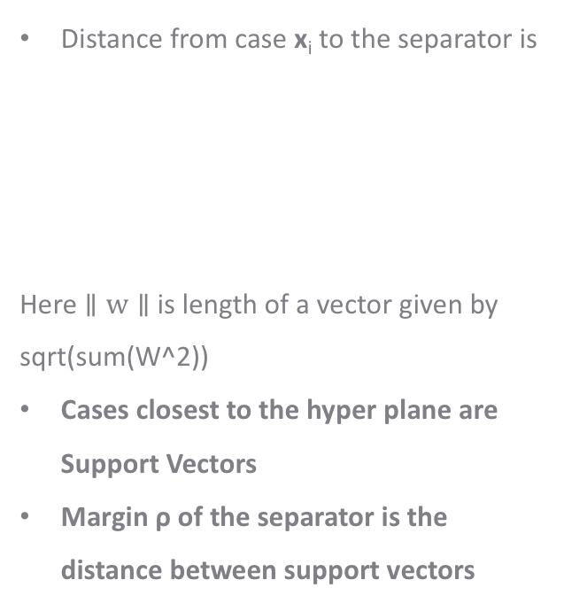

Classification Margin
Distance from case x_{i} to the separator is
Here $∥w∥$ is length of a vector given by sqrt(sum(W^2))
Cases closest to the hyper plane are Support Vectors
Margin ρ of the separator is the distance between support vectors
$$ρ$$
r
$$r=\frac{w^{T}x_{i}+b}{∥w∥}$$

Slide 8
Maximum Margin Classification
The objective is now to maximize the margin ρ of the separator
The focus is on ‘Support Vectors’
Other cases are not considered in the algorithm

Slide 9
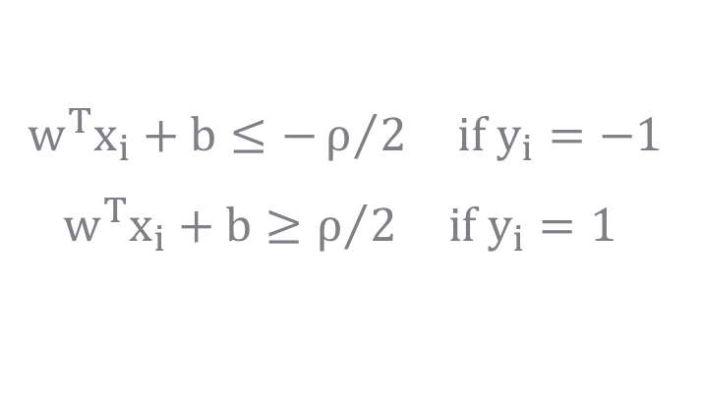
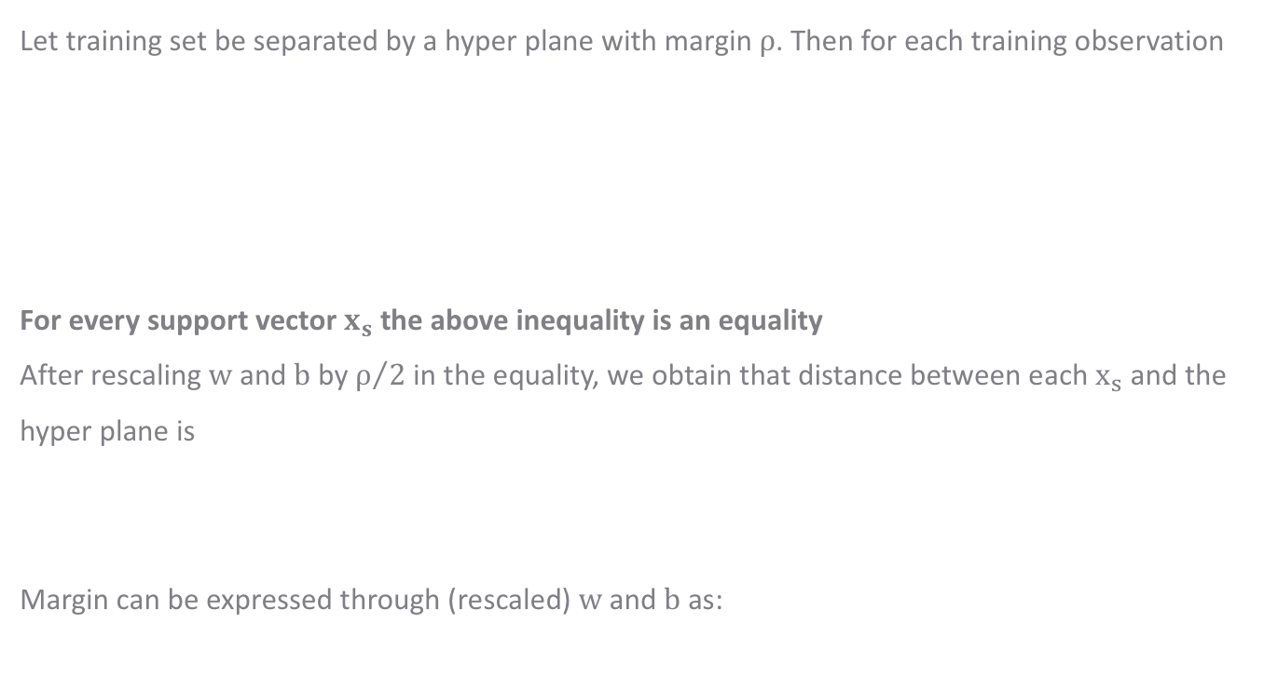

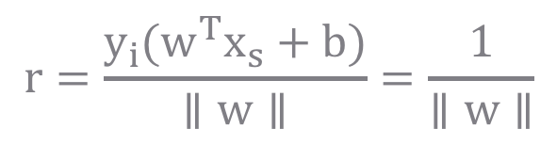

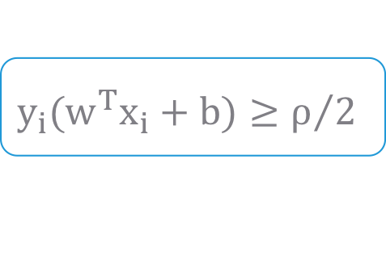
Mathematical Approach to Linear SVM
Let training set be separated by a hyper plane with margin $ρ$. Then for each training observation
For every support vector $x_{s}$ the above inequality is an equality
After rescaling $w$ and $b$ by $ρ/2$ in the equality, we obtain that distance between each $x_{s}$ and the hyper plane is
Margin can be expressed through (rescaled) $w$ and $b$ as:
$$w^{T}x_{i}+b≤−ρ/2 if y_{i}=−1$$
$$w^{T}x_{i}+b≥ρ/2 if y_{i}=1$$
$$y_{i}(w^{T}x_{i}+b)≥ρ/2$$
$$↔$$
$$r=\frac{{y_{i}(w}^{T}x_{s}+b)}{∥w∥}=\frac{1}{∥w∥}$$
$$ρ=2r=\frac{2}{∥w∥}$$

Slide 10
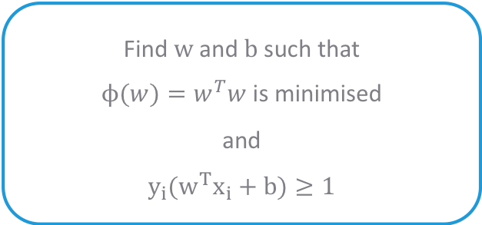

Mathematical Approach to Linear SVM
Quadratic Optimisation problem is:
which can be reformulated as:
Find $w$ and $b$ such that
$ρ=\frac{2}{∥w∥}$ is maximised
and
$$y_{i}(w^{T}x_{i}+b)≥1$$
Find $w$ and $b$ such that
$ϕ(w)=w^{T}w$ is minimised
and
$$y_{i}(w^{T}x_{i}+b)≥1$$

Slide 11
Case Study – Predicting Loan Defaulters
Background
Objective
Available Information
The bank possesses demographic and transactional data of its loan customers. If the bank has a robust model to predict defaulters it can undertake better resource allocation.
To predict whether the customer applying for the loan will be a defaulter
Defaulter (=1 if defaulter, 0 otherwise) is the dependent variable
Age group, Years at current address, Years at current employer, Debt to Income Ratio, Credit Card Debts, Other Debts are the independent variables
Sample size is 700

Slide 12
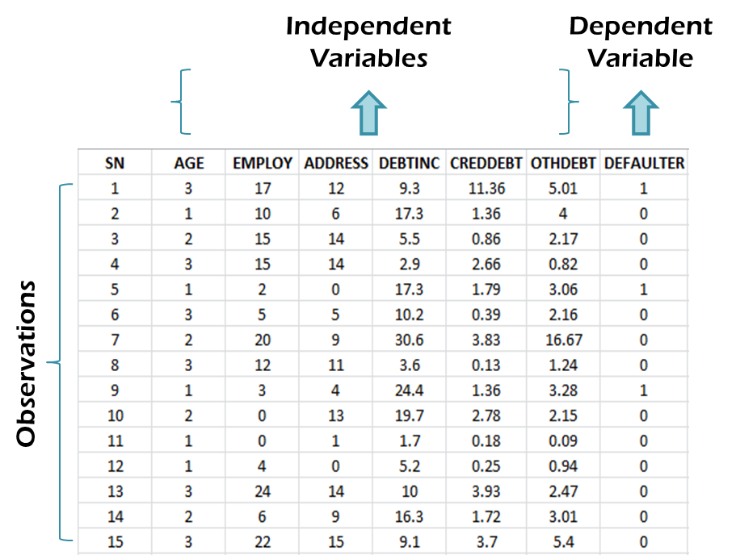
Data Snapshot
BANK LOAN
Column | Description | Type | Measurement | Possible Values
SN | Serial Number | - | - | -
AGE | Age Groups | Integer | 1(<28 years),2(28-40 years),3(>40 years) | 3
EMPLOY | Number of years customer working at current employer | Integer | - | Positive value
ADDRESS | Number of years customer staying at current address | Integer | - | Positive value
DEBTINC | Debt to Income Ratio | Continuous | - | Positive value
CREDDEBT | Credit to Debit Ratio | Continuous | - | Positive value
OTHDEBT | Other Debt | Continuous | - | Positive value
DEFAULTER | Whether customer defaulted on loan | Integer | 1(Defaulter), 0(Non-Defaulter) | 2

Slide 13
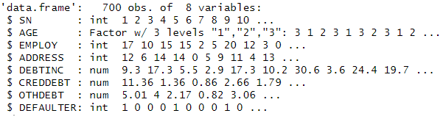
SVM in R
# Importing and Readying the Data
bankloan<-read.csv("BANK LOAN.csv",header=T) bankloan$AGE<-as.factor(bankloan$AGE) str(bankloan)
as.factor() changes age from an integer to a factor variable.
str() is used to check if the conversion to factor has taken place and if all other variable formats are appropriate, before moving to SVM modeling.
# Output

Slide 14
SVM in R
# SVM Using Package "e1071"
install.packages("e1071") library(e1071) model<-svm(formula=DEFAULTER~AGE+EMPLOY+ADDRESS+ DEBTINC+CREDDEBT+OTHDEBT,data=bankloan, type="C",probability=TRUE,kernel="linear") Model coef(model)
svm() trains a support vector machine.
formula= gives the model to be fit.
data= specifies the data object.
type= specifies whether SVM is used for classification or regression or novelty detection. Default for type= is "C“.
probability= logical for indicating whether model should allow for probability predictions.
kernel= specifies the kernel used in training and predicting. Here, we have kept kernel as linear.

Slide 15
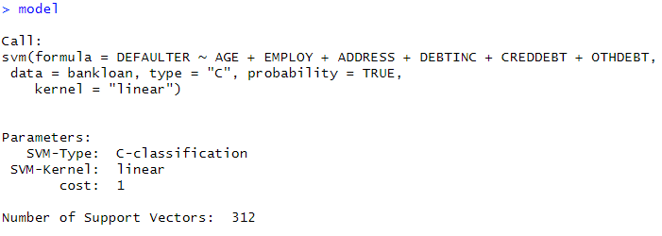
SVM in R
# Output

Slide 16
Predictions Based on SVM
# Predictions
pred1<-predict(model,bankloan,probability=TRUE) pred2<-attr(pred1,"probabilities")[,1]
predict() returns predicted probabilities based on the model results and historical data.
First argument is the svm() model object while the second argument is original dataset.
probability=TRUE returns raw probabilities. This argument is valid only when type="probability“ is specified in svm().
pred1<-predict(model,bankloan,decision.values =TRUE ) gives scores
attr(), from base R, is used get or set specific attributes of an object. Here, we want to get the predicted probabilities obtained by the svm() model.
First argument is the name of the object whose attributes we want to extract.
Second argument is the character string specifying which attribute is to be accessed. Check pred1 to know the exact name, which is "probabilities".

Slide 17
ROC Curve and Area Under ROC Curve
#ROC Curve
prediction() creates object of class prediction, required for ROC curve. performance() calculates predictor evaluations.
Using measure="tpr", measure="fpr” we can plot an ROC Curve.
abline() adds a straight line to the plot.
install.packages("ROCR") library(ROCR) pred<-prediction(pred2,bankloan$DEFAULTER) perf<-performance(pred,"tpr","fpr") plot(perf) abline(0,1)

Slide 18
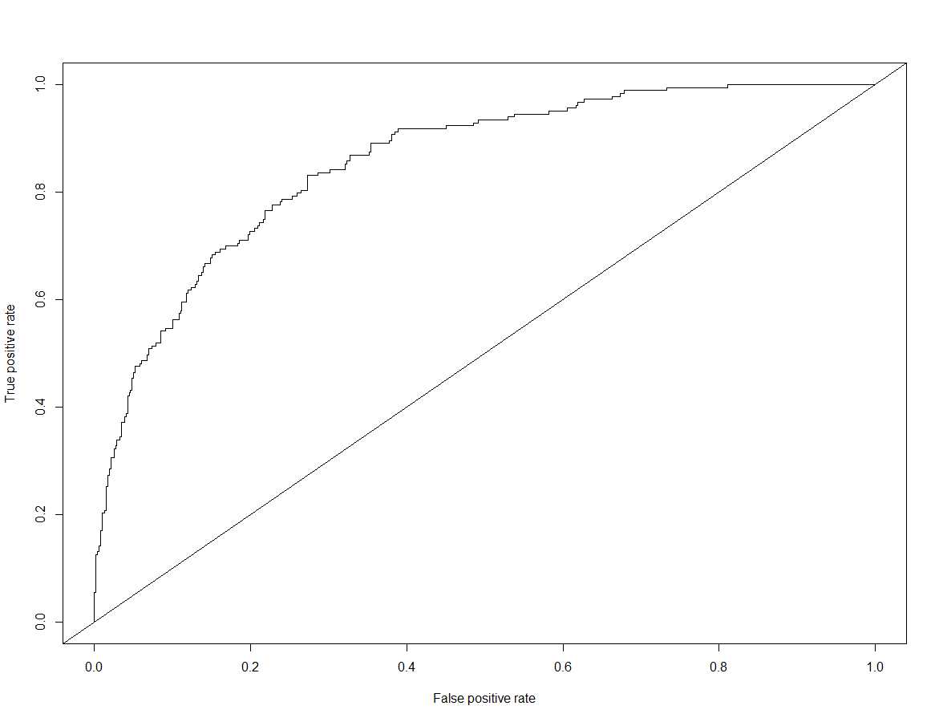
ROC Curve and Area Under ROC Curve
# Output
# Area Under ROC Curve
auc<-performance(pred,"auc") auc@y.values [[1]] [1] 0.855577
“auc” in performance() calculates Area Under ROC Curve.

Slide 19
Quick Recap
Support Vector Machines
SVMs find a hyper plane which separates the d-dimensional data perfectly into its classes
SVM in R
Package "e1071" has svm() that trains a support vector machine
The function takes arguments to specify whether svm() is to be used for classification or regression; if probabilities are to be returned and which kernel to use for training and predicting

Slide 20
THANK YOU!!

